Slide 1

A day in Reception

Slide 2
Daily Routine:
Doors will open at 08.45am and close at 9.05am. If you arrive after 9.05am, please use the main office entrance and your child will be brought through into Reception class.
The dinner menu and bands will be on the table, please choose a meal you think your child will like the best.
Then your child can walk straight into Reception and they will be supported to follow the morning routines.
Home time – The door will open at 3pm but you have until 3.15pm to collect your child. Thank you for your patience as we try to remember your faces.

Slide 3
Polite Reminders:
Please can book bags be brought to school every day.
PE is on Friday mornings. Please can your child come to school wearing their PE kit. They will stay in their kit all day.
Jewellery, including hooped earrings are not allowed.
Dinner times - please let us know if you have any concerns about how much your child is eating.
Please can you put your child’s name in all items of their clothing, especially jumpers and cardigans.

Slide 4
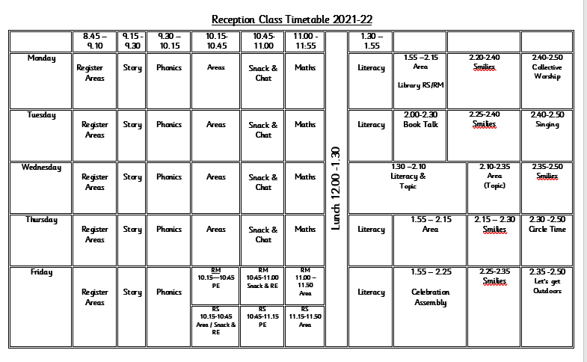
Let’s have a look at the timetable……

Slide 5


Mathematics
4 times a week, carpet and small group activities.
These are some of things we will be covering:
Counting reliably
Early Maths songs
Reading numbers
Writing numbers
Simple addition activities
Simple subtraction activities
Shapes and pattern activities
Working with objects using language related to size

Slide 6

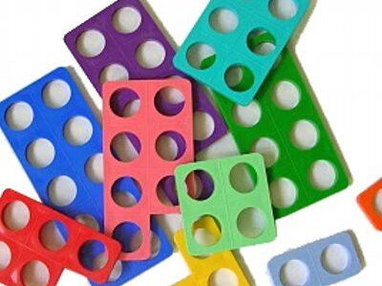
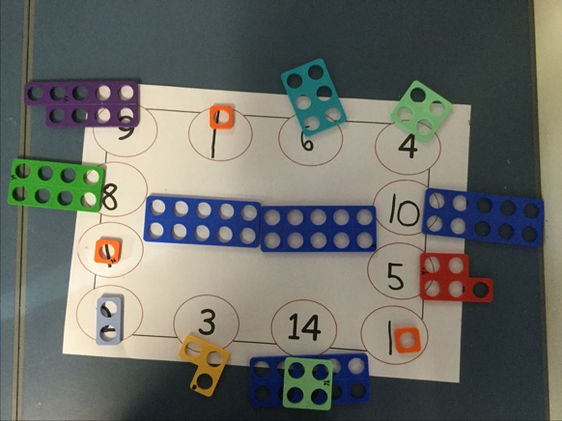
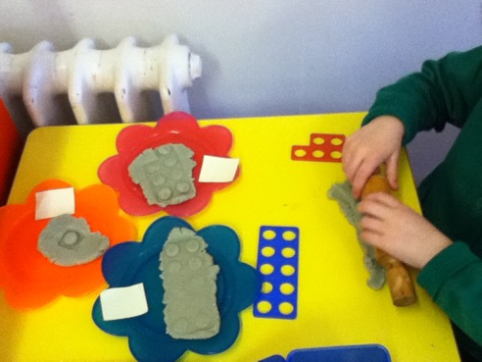
We teach using the Numicon Maths Scheme. It is a visual and kinaesthetic way of understanding number. The children will be playing games to develop their confidence with the number plates and using the Numicon to solve many different mathematical problems.

Slide 7



Slide 8

Why Read Write Inc Phonics?
Tried and tested over many years
Systematic and structured
Early success in reading
Training and ongoing staff development

Slide 9
What is Read Write Inc Phonics?
A rapid learn to read programme
so children can…
Read to learn for the rest of their lives

Slide 10
How does it work?
Children:
Learn 44 sounds and matching letters/letter groups
Learn to blend sounds to read words
Read lots of specially written books
This is decoding

Slide 11
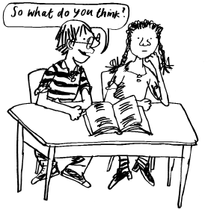
How does it work?
Children:
Talk a lot about what they have read to show they understand
Listen to and discuss other ideas to deepen understanding
This is comprehending

Slide 12
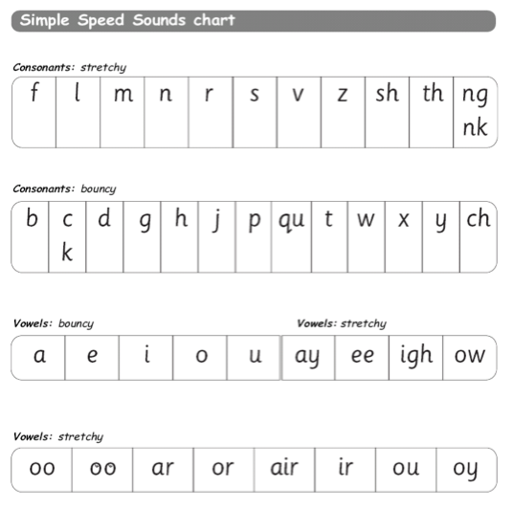
Learning the code
Children learn a simple code first – pure sounds. Please subscribe to the Ruth Miskin YouTube channel to listen to how these sounds are spoken or click the link below.
https://www.youtube.com/watch?v=TkXcabDUg7Q

Slide 13

Fred...
Fred helps children learn to read
Fred can only talk in sounds...
(Fred can only say c_a_t, he can’t say cat)
We call this Fred Talk

Slide 14
Fred...
If children understand Fred they can blend orally
Blending is needed for reading

Slide 15

































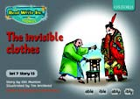














Storybooks and Get Writing Books

Slide 16
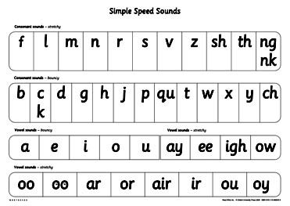

So how can you help your child?
By knowing the 44 pure sounds
By knowing how to blend using Fred Talk for reading m_a_t
By knowing how to do Fred Fingers for spelling

Slide 17
And...
By having fun with Fred Talk at home!
“What a tidy r-oo-m!”
“Where’s your c-oa-t?”
“Time for b-e-d!”

Slide 18
And...
By reading to your child lots of lovely stories and asking lots of questions!
Use these prompts to help you:
What do you think
happens next?
What is that character thinking?
What is happening?
What do you
think that character is
feeling now?
What is the character saying?
Notes:
Reading to your child lots of lovely stories that are at a higher level than your child can read yet.
School might want to make these prompts, laminate them and send them home in book bags?
What is happening in this part of the story?

Slide 19
And...
By talking to your child as much as possible and ‘feeding’ them new and different words:
“Let’s eat our lunch now.”
“Let’s munch our lunch now.”
“Let’s scoff our lunch now.”

Slide 20
And...
By enriching conversations through description:
“Look at that rain. It looks like little diamonds sparkling on the window pane!”
By having fun with words and language.
“I’m as hot as a spud in a cooking pot!”
By praising your child for using new words or interesting images

Slide 21


And...
By having a look at the parents’ pages on the YouTube channel for tips and videos for supporting your child at home,
Or by visiting
www.ruthmiskin.com
(RWI resources are published by
Oxford University Press)

Slide 22
Literacy
Carpet and small group activities.
These are some of the skills we will be looking at:
Stories and story structure.
Speaking and listening skills.
Handwriting and letter formation.
Purposeful writing (writing for a real life purpose). For example: lists and letters.

Slide 23
Topic
Through our topic sessions we will cover a variety of areas such as expressive arts and design, understanding the world and personal, social and emotional development.
We have a different topic every half term, our topics this year are:
All about me, including Favourite Stories
Celebrations
Our World
New Life / Growing
Adventures
People who help us

Slide 24
Home School links
Throughout the year, we will sending home simple, fun learning activities for you to do with your child. This is usually based around our topic theme. Please could you complete this with your child and send it back to school.
We would also like you to share with us photos of exciting events or ‘wow’ moments. You can email these to your class teacher.
Miss Davey:kate.davey@bsl.leeds.sch.uk
Mrs Sandy: heidi.sandy@bsl.leeds.sch.uk

Slide 25


Information, Communication and Technology
During the school week, the children will also have one session of Information, Communication and Technology where they will be given the opportunity to access the computer room and iPads.
Technology is also used in other areas of the day such as through the Smartboard and computer area.
The children also have the opportunity to use cameras and the listening centre.

Slide 26
Physical Development
The children will have a PE lesson once a week. This is based indoors and outdoors. The children develop a variety of skills including movement, control, dance, games, climbing and control over an object.
The children will also have daily access to our outdoor provision. Please ensure that your child has appropriate clothing and footwear.
Every week, we will also be accessing the school woodland area to explore and observe the changes over the seasons.
Please can you name your child’s PE kit.

Slide 27
Religious Education and Collective worship
During the school week the children listen to and explore simple and relevant Bible stories, using books and props.
They also take part in circle time where we talk about subjects relevant to the children, for example, what makes us happy and being kind to our friends.
The children will also have the opportunity to pray and worship together - this could be singing simple songs or joining in with our prayer time.

Slide 28
Thank you for your continued support.
The Reception Team

